Slide 1


K-Modes Algorithm
Dr. Yilmaz
12/14/2023

Slide 2
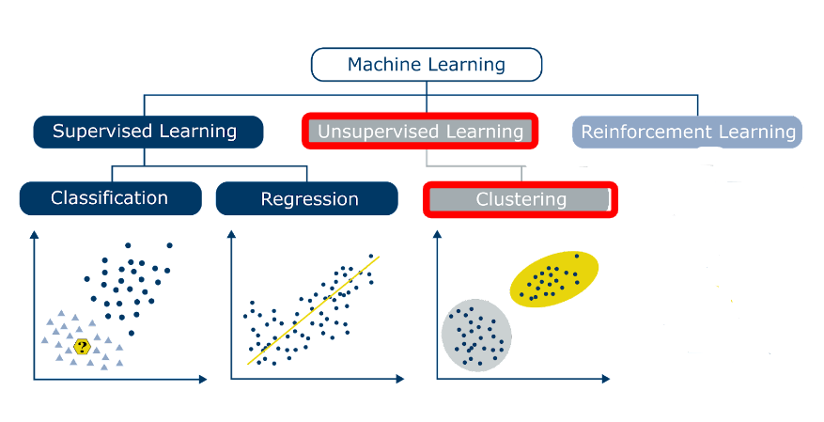

Slide 3
K-Means Algorithm
Step 1: Choose a K K represents the number of centroids (i.e. clusters)
Step 2: Randomly select centroids positions
Step 3: Calculate distances between each data point and K centroids to figure out
the closest cluster
Step 4: Calculate the mean of each cluster
Use the mean value as the new centroid
Step 5: Repeat step 3 and 4 until any of the following condition is met:
Centroids of newly formed clusters do not change
Points remain in the same cluster
Maximum number of iterations are reached

Slide 4
K-Means: Advantages and Disadvantages
Advantages:
Easy to implement.
K-means model dynamically updated: centroid can be updated if new dataset is added.
Disadvantages:
Hard to guess K
Initial centroid can impact results
K-means is time consuming. Need to calculate distances between new centroid in every loop.
Works only for quantitative continuous data
K-means method may not find out the global best solution. It sometimes returns local optimum.
K-means is limited to linear cluster boundaries.

Slide 5
K-modes:
Example: Ancestry study: Group these people based on the given data
Person | Hair color | Eye color | Height
P1 | blonde | amber | tall
P2 | brunette | gray | short
P3 | red | green | short
P4 | black | hazel | short
P5 | brunette | amber | tall
P6 | black | gray | short
P7 | red | green | tall
P8 | black | hazel | tall

Slide 6
K-modes:
P1 | blonde | amber | tall
P7 | red | green | tall
P8 | black | hazel | tall
Step 1: Pick K=3 initial centroids
Person | Hair color | Eye color | Height
P1 | blonde | amber | tall
P2 | brunette | gray | short
P3 | red | green | short
P4 | black | hazel | short
P5 | brunette | amber | tall
P6 | black | gray | short
P7 | red | green | tall
P8 | black | hazel | tall

Slide 7
K-modes:
P1 | blonde | amber | tall
P7 | red | green | tall
P8 | black | hazel | tall
Centroids
Step 2: Find distance from each data point to each centroid
Calculate the dissimilarities
(= number of mismatches)
and assign each data point to
its closest cluster
Person | Hair color | Eye color | Height
P1 | blonde | amber | tall
P2 | brunette | gray | short
P3 | red | green | short
P4 | black | hazel | short
P5 | brunette | amber | tall
P6 | black | gray | short
P7 | red | green | tall
P8 | black | hazel | tall
Dissimilarity to P1
0
3
3
3
1
3
2
2
Data

Slide 8
K-modes:
P1 | blonde | amber | tall
P7 | red | green | tall
P8 | black | hazel | tall
Centroids
Step 2: Find distance from each data point to each centroid
Calculate the dissimilarities
(= number of mismatches)
and assign each data point to
its closest cluster
Person | Hair color | Eye color | Height
P1 | blonde | amber | tall
P2 | brunette | gray | short
P3 | red | green | short
P4 | black | hazel | short
P5 | brunette | amber | tall
P6 | black | gray | short
P7 | red | green | tall
P8 | black | hazel | tall
Dissimilarity to P7
2
3
1
3
2
3
0
2
Data

Slide 9
K-modes:
P1 | blonde | amber | tall
P7 | red | green | tall
P8 | black | hazel | tall
Centroids
Step 2: Find distance from each data point to each centroid
Calculate the dissimilarities
(= number of mismatches)
and assign each data point to
its closest cluster
Person | Hair color | Eye color | Height
P1 | blonde | amber | tall
P2 | brunette | gray | short
P3 | red | green | short
P4 | black | hazel | short
P5 | brunette | amber | tall
P6 | black | gray | short
P7 | red | green | tall
P8 | black | hazel | tall
Dissimilarity to P8
2
3
3
1
2
2
2
0
Data

Slide 10
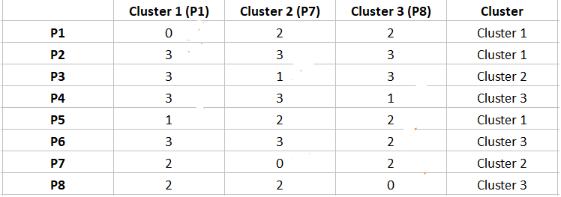
K-modes:
Step 2: Find distance from each data point to each centroid and determine memberships
Dissimilarity Matrix

Slide 11
K-modes
Step 3: Calculate new centroids using modes
Cluster 1 -Yellow: (brunette, amber, tall)
Cluster 2- Red: ?
Cluster 3- Purple: ?
Person | Hair color | Eye color | Height
P1 | blonde | amber | tall
P2 | brunette | gray | short
P3 | red | green | short
P4 | black | hazel | short
P5 | brunette | amber | tall
P6 | black | gray | short
P7 | red | green | tall
P8 | black | hazel | tall

Slide 12
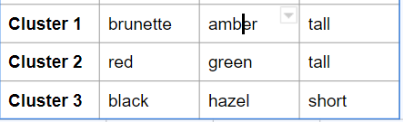
K-modes
New Centroids
Step 3:
Calculated new centroids using modes
Person | Hair color | Eye color | Height
P1 | blonde | amber | tall
P2 | brunette | gray | short
P3 | red | green | short
P4 | black | hazel | short
P5 | brunette | amber | tall
P6 | black | gray | short
P7 | red | green | tall
P8 | black | hazel | tall
Data

Slide 13
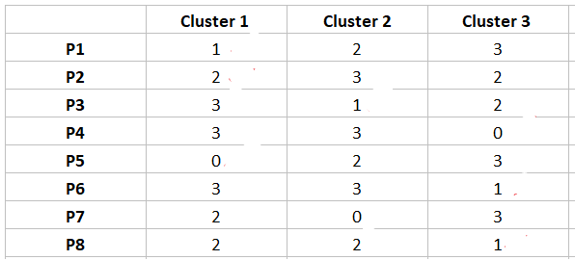
K-modes
Step 4: Go back to Step 2 to find distance from each data point to each centroid
Dissimilarity Matrix

Slide 14
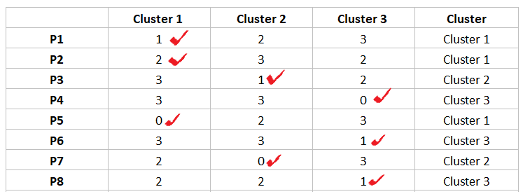
K-modes
Step 4: Go back to Step 2 to find distance from each data point to each centroid
and determine the memberships
Dissimilarity Matrix
Memberships
stayed the same: Stop!

Slide 15
References:
https://jakevdp.github.io/PythonDataScienceHandbook/05.11-k-means.html
http://cs229.stanford.edu/notes2021fall/lecture12-kmeans.pdf
https://www.analyticsvidhya.com/blog/2019/08/comprehensive-guide-k-means-clustering/
https://www.analyticsvidhya.com/blog/2021/06/kmodes-clustering-algorithm-for-categorical-data/

